Slide 1
State Tobacco Activities Tracking and Evaluation (STATE) System Current Cigarette Use Among Adults
Behavior Risk Factor Surveillance System, 2019
http://www.cdc.gov/statesystem

Slide 2
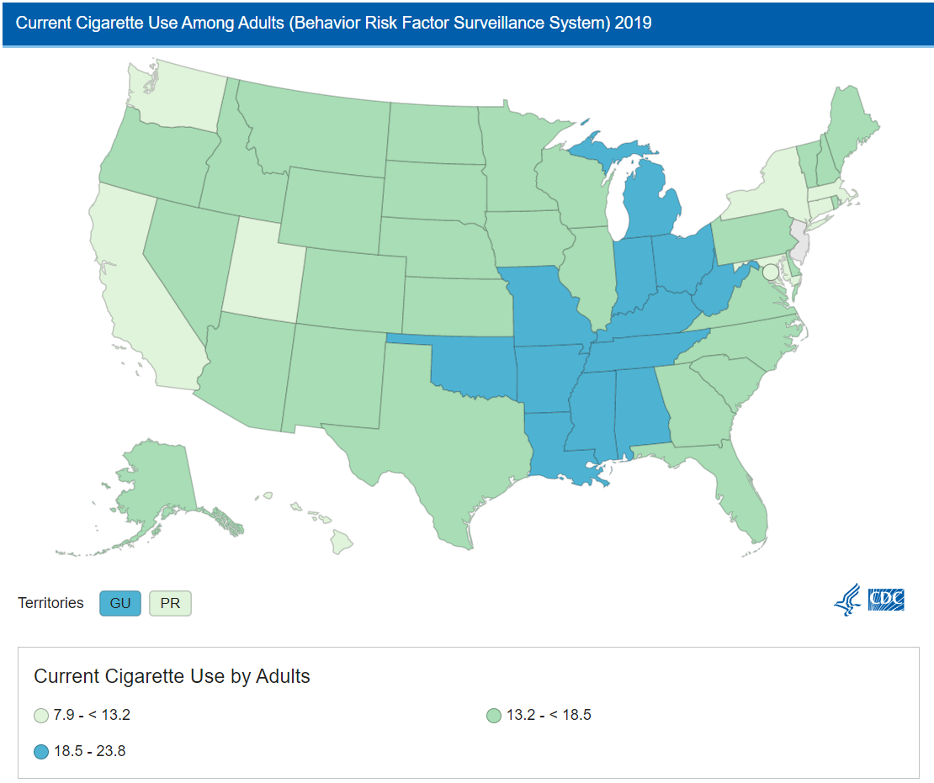
Current Cigarette Use Among Adults
Centers for Disease Control and Prevention (CDC). State Tobacco Activities Tracking and Evaluation (STATE) System. Updated 10/2021
Notes:
This is a map of current cigarette use among adults aged 18 and over. The data are grouped into 5 classes using natural breaks. The range is from 10.3% to 27.3%. (No data for US Territories).

Slide 3
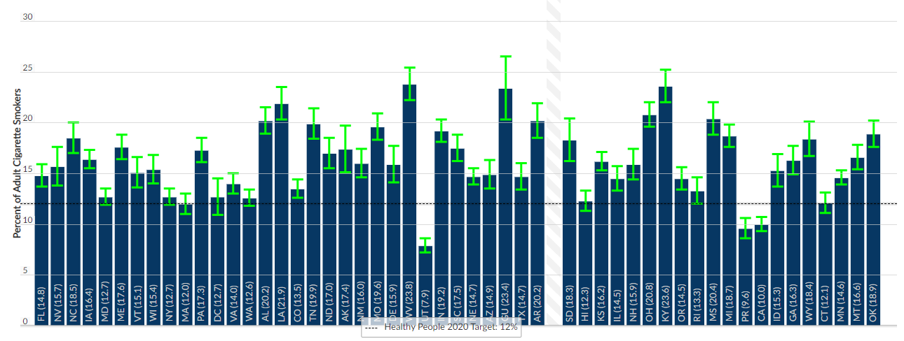
Current Cigarette Use Among Adults
Centers for Disease Control and Prevention (CDC). State Tobacco Activities Tracking and Evaluation (STATE) System. Updated 10/2021

Slide 4
Current Cigarette Use Among Adults
Location | Data Value | Low Confidence Limit | High Confidence Limit | Sample Size
Alabama | 20.2% | 18.9% | 21.5% | 6,744
Alaska | 17.4% | 15.1% | 19.7% | 2,849
Arizona | 14.9% | 13.5% | 16.3% | 8,468
Arkansas | 20.2% | 18.5% | 21.9% | 5,116
California | 10.0% | 9.3% | 10.7% | 10,861
Colorado | 13.5% | 12.6% | 14.4% | 8,664
Connecticut | 12.1% | 11.1% | 13.1% | 8,665
Delaware | 15.9% | 14.1% | 17.7% | 3,705
District of Columbia | 12.7% | 10.9% | 14.5% | 2,420
Florida | 14.8% | 13.7% | 15.9% | 15,824
Georgia | 16.3% | 14.9% | 17.7% | 6,847
Guam | 23.4% | 20.3% | 26.5% | 2,323
Hawaii | 12.3% | 11.3% | 13.3% | 7,396
Idaho | 15.3% | 13.7% | 16.9% | 5,304
Illinois | 14.5% | 13.3% | 15.7% | 5,338
Indiana | 19.2% | 18.1% | 20.3% | 8,427
Iowa | 16.4% | 15.5% | 17.3% | 9,467
Kansas | 16.2% | 15.3% | 17.1% | 10,814
Kentucky | 23.6% | 22.0% | 25.2% | 7,735
Louisiana | 21.9% | 20.3% | 23.5% | 4,456
Maine | 17.6% | 16.4% | 18.8% | 11,048
Maryland | 12.7% | 11.9% | 13.5% | 16,547
Massachusetts | 12.0% | 11.0% | 13.0% | 7,394
Michigan | 18.7% | 17.6% | 19.8% | 10,181
Minnesota | 14.6% | 13.9% | 15.3% | 14,884
Mississippi | 20.4% | 18.8% | 22.0% | 4,945
Missouri | 19.6% | 18.3% | 20.9% | 7,088
Montana | 16.6% | 15.4% | 17.8% | 6,299
Location | Data Value | Low Confidence Limit | High Confidence Limit | Sample Size
Nebraska | 14.7% | 13.9% | 15.5% | 15,301
Nevada | 15.7% | 13.8% | 17.6% | 2,702
New Hampshire | 15.9% | 14.4% | 17.4% | 5,481
New Jersey | N/A | N/A | N/A | N/A
New Mexico | 16.0% | 14.6% | 17.4% | 5,746
New York | 12.7% | 11.9% | 13.5% | 13,230
North Carolina | 18.5% | 17.0% | 20.0% | 4,131
North Dakota | 17.0% | 15.5% | 18.5% | 5,427
Ohio | 20.8% | 19.6% | 22.0% | 12,925
Oklahoma | 18.9% | 17.6% | 20.2% | 6,036
Oregon | 14.5% | 13.4% | 15.6% | 5,873
Pennsylvania | 17.3% | 16.1% | 18.5% | 6,385
Puerto Rico | 9.6% | 8.6% | 10.6% | 5,938
Rhode Island | 13.3% | 12.0% | 14.6% | 5,710
South Carolina | 17.5% | 16.2% | 18.8% | 6,857
South Dakota | 18.3% | 16.2% | 20.4% | 6,496
Tennessee | 19.9% | 18.4% | 21.4% | 5,885
Texas | 14.7% | 13.4% | 16.0% | 11,623
Utah | 7.9% | 7.2% | 8.6% | 11,496
Vermont | 15.1% | 13.6% | 16.6% | 6,125
Virginia | 14.0% | 13.0% | 15.0% | 9,492
Washington | 12.6% | 11.8% | 13.4% | 12,234
West Virginia | 23.8% | 22.2% | 25.4% | 5,193
Wisconsin | 15.4% | 14.0% | 16.8% | 4,739
Wyoming | 18.4% | 16.7% | 20.1% | 4,506
Centers for Disease Control and Prevention (CDC). State Tobacco Activities Tracking and Evaluation (STATE) System. Updated 10/2021

Slide 5
Based on OSHData Dataset: Behavioral Risk Factor Data: Tobacco Use (2011 to present)
2011-2019. Centers for Disease Control and Prevention (CDC). State Tobacco Activities Tracking and Evaluation (STATE) System. BRFSS Survey Data. The BRFSS is a continuous, state-based surveillance system that collects information about modifiable risk factors for chronic diseases and other leading causes of death. The data for the STATE System were extracted from the annual BRFSS surveys from participating states. Tobacco topics included are cigarette and e-cigarette use prevalence by demographics, cigarette and e-cigarette use frequency, and quit attempts. NOTE: these data are not to be compared with BRFSS data collected 2010 and prior, as the methodologies were changed. Please refer to the FAQs / Methodology sections for more details.
https://chronicdata.cdc.gov/Survey-Data/Behavioral-Risk-Factor-Data-Tobacco-Use-2011-to-pr/wsas-xwh5

Slide 7
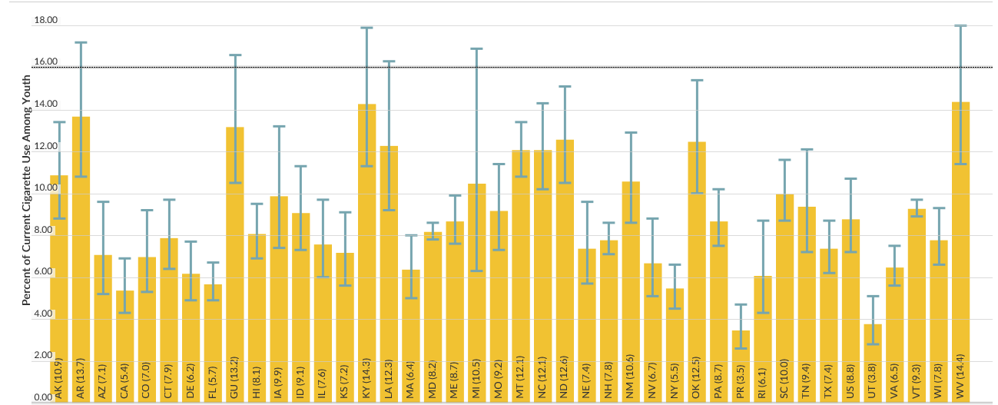
Current Cigarette Use Among Youth*
*Not all states have data reported.
Centers for Disease Control and Prevention (CDC). State Tobacco Activities Tracking and Evaluation (STATE) System. Updated 12/2018

Slide 8
Current Cigarette Use Among Youth*
Location | Data Value | Low Confidence Limit | High Confidence Limit | Sample Size
Alabama | N/A | N/A% | N/A% | N/A
Alaska | 10.9% | 8.8% | 13.4% | 1,287
Arizona | 7.1% | 5.2% | 9.6% | 2,030
Arkansas | 13.7% | 10.8% | 17.2% | 1,535
California | 5.4% | 4.3% | 6.9% | 1,718
Colorado | 7.0% | 5.3% | 9.2% | 1,489
Connecticut | 7.9% | 6.4% | 9.7% | 2,404
Delaware | 6.2% | 4.9% | 7.7% | 2,820
District of Columbia | N/A | N/A% | N/A% | N/A
Florida | 5.7% | 4.9% | 6.7% | 5,920
Georgia | N/A | N/A% | N/A% | N/A
Guam | 13.2% | 10.5% | 16.6% | 1,079
Hawaii | 8.1% | 6.9% | 9.5% | 5,895
Idaho | 9.1% | 7.3% | 11.3% | 1,774
Illinois | 7.6% | 6% | 9.7% | 4,649
Indiana | N/A | N/A% | N/A% | N/A
Iowa | 9.9% | 7.4% | 13.2% | 1,624
Kansas | 7.2% | 5.6% | 9.1% | 2,336
Kentucky | 14.3% | 11.3% | 17.9% | 1,898
Louisiana | 12.3% | 9.2% | 16.3% | 1,107
Maine | 8.7% | 7.6% | 9.9% | 9,100
Maryland | 8.2% | 7.8% | 8.6% | 50,735
Massachusetts | 6.4% | 5% | 8% | 3,211
Michigan | 10.5% | 6.3% | 16.9% | 1,574
Minnesota | N/A | N/A% | N/A% | N/A
Mississippi | N/A | N/A% | N/A% | N/A
Missouri | 9.2% | 7.3% | 11.4% | 1,791
Montana | 12.1% | 10.8% | 13.4% | 4,642
Nebraska | 7.4% | 5.7% | 9.6% | 1,367
Nevada | 6.7% | 5.1% | 8.8% | 1,612
New Hampshire | 7.8% | 7.1% | 8.6% | 11,910
New Jersey | N/A | N/A% | N/A% | N/A
New Mexico | 10.6% | 8.6% | 12.9% | 5,553
New York | 5.5% | 4.5% | 6.6% | 10,944
North Carolina | 12.1% | 10.2% | 14.3% | 3,130
North Dakota | 12.6% | 10.5% | 15.1% | 2,114
Ohio | N/A | N/A% | N/A% | N/A
Oklahoma | 12.5% | 10% | 15.4% | 1,580
Oregon | N/A | N/A% | N/A% | N/A
Pennsylvania | 8.7% | 7.5% | 10.2% | 3,599
Puerto Rico | 3.5% | 2.6% | 4.7% | 1,572
Rhode Island | 6.1% | 4.3% | 8.7% | 2,120
South Carolina | 10.0% | 8.7% | 11.6% | 1,385
South Dakota | N/A | N/A% | N/A% | N/A
Tennessee | 9.4% | 7.2% | 12.1% | 1,929
Texas | 7.4% | 6.2% | 8.7% | 2,007
Utah | 3.8% | 2.8% | 5.1% | 1,781
Vermont | 9.3% | 8.9% | 9.7% | 20,194
Virginia | 6.5% | 5.6% | 7.5% | 3,590
Washington | N/A | N/A% | N/A% | N/A
West Virginia | 14.4% | 11.4% | 18% | 1,496
Wisconsin | 7.8% | 6.6% | 9.3% | 1,996
Wyoming | N/A | N/A% | N/A% | N/A
*Not all states have data reported.
Centers for Disease Control and Prevention (CDC). State Tobacco Activities Tracking and Evaluation (STATE) System. Updated 12/2018

Slide 9
Based on OSHData dataset: Youth Risk Behavioral Surveillance System (YRBSS) Data
1993, 1995, 1997, 1999, 2001, 2003, 2005, 2007, 2009, 2011, 2013, 2015, 2017. Centers for Disease Control and Prevention (CDC). State Tobacco Activities Tracking and Evaluation (STATE) System. YRBSS Data. The YRBS is conducted biennially and collects data on a variety of youth risk behaviors including tobacco use. The YRBS uses a two-stage cluster sample design to produce representative samples of students in high schools (grades 9-12). The YRBS uses SUDAAN to calculate asymmetric confidence intervals based on the logit transformation. The logit transformation constrains confidence interval limits to vary between a lower limit of 0% and an upper limit of 100%. The data for the STATE System were extracted from YRBSS surveys from participating states. Tobacco topics include cigarette and e-cigarette use prevalence, cigarette and e-cigarette use frequency, and smokeless tobacco products
https://chronicdata.cdc.gov/Survey-Data/Youth-Risk-Behavioral-Surveillance-System-YRBSS-Da/3596-ayf6

Slide 11
State Tobacco Activities Tracking and Evaluation (STATE) System Excise Tax Rates on Packs of Cigarettes
In effect as of December 31, 2022
http://www.cdc.gov/statesystem

Slide 12
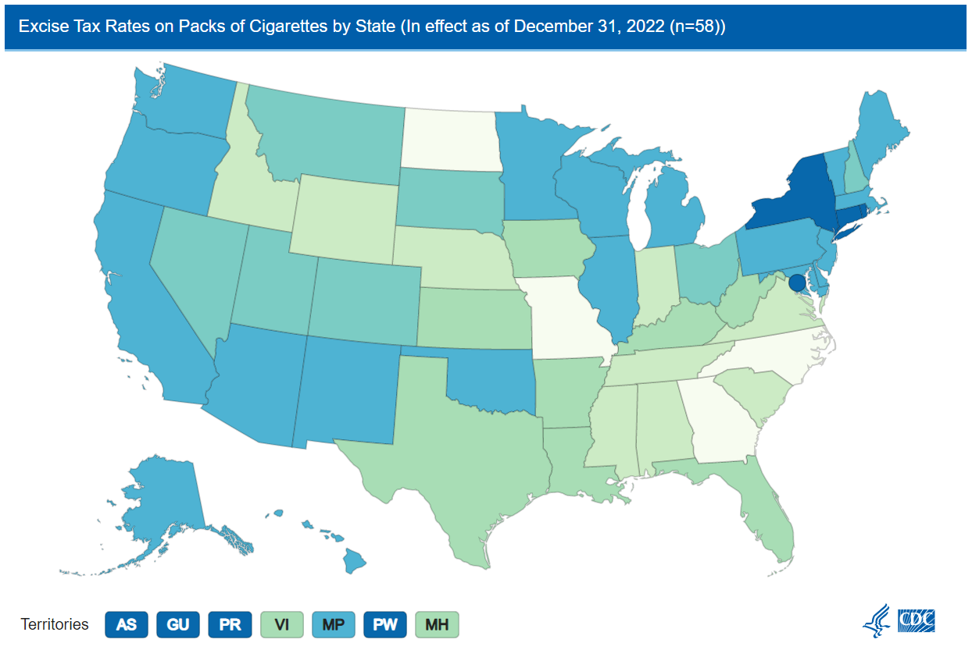
Excise Tax Rates on Packs of Cigarettes
*Virgin Islands = U.S. Virgin Islands
Centers for Disease Control and Prevention (CDC). State Tobacco Activities Tracking and Evaluation (STATE) System. Updated 03/2023
Notes:
This is a map of current excise tax rates on packs of cigarettes. The data are grouped into 5 classes using natural breaks. The range is from $0.17 to $6.00.

Slide 13
Excise Tax Rates on Packs of Cigarettes
Location | Excise Tax
Alabama | $ 0.675
Alaska | $ 2.000
American Samoa | $ 6.000
Arizona | $ 2.000
Arkansas | $ 1.150
California | $ 2.870
Colorado | $ 1.940
Connecticut | $ 4.350
Delaware | $ 2.100
District of Columbia | $ 5.010
Florida | $ 1.339
Georgia | $ 0.370
Guam | $ 4.000
Hawaii | $ 3.200
Idaho | $ 0.570
Illinois | $ 2.980
Indiana | $ 0.995
Iowa | $ 1.360
Kansas | $ 1.290
Kentucky | $ 1.100
Louisiana | $ 1.080
Maine | $ 2.000
Marshall Islands | $ 1.000
Maryland | $ 3.750
Massachusetts | $ 3.510
Michigan | $ 2.000
Minnesota | $ 3.040
Mississippi | $ 0.680
Missouri | $ 0.170
Montana | $ 1.700
Location | Excise Tax
Nebraska | $ 0.640
Nevada | $ 1.800
New Hampshire | $ 1.780
New Jersey | $ 2.700
New Mexico | $ 2.000
New York | $ 4.350
North Carolina | $ 0.450
North Dakota | $ 0.440
Northern Marianas | $ 3.750
Ohio | $ 1.600
Oklahoma | $ 2.030
Oregon | $ 3.330
Palau | $ 5.000
Pennsylvania | $ 2.600
Puerto Rico | $ 5.100
Rhode Island | $ 4.250
South Carolina | $ 0.570
South Dakota | $ 1.530
Tennessee | $ 0.620
Texas | $ 1.410
Utah | $ 1.700
Vermont | $ 3.080
Virgin Islands | $ 1.100
Virginia | $ 0.600
Washington | $ 3.025
West Virginia | $ 1.200
Wisconsin | $ 2.520
Wyoming | $ 0.600
*Virgin Islands = U.S. Virgin Islands
Centers for Disease Control and Prevention (CDC). State Tobacco Activities Tracking and Evaluation (STATE) System. Updated 03/2023

Slide 14

State of the States
22 states, 5 Territories, and DC currently have a cigarette excise tax of $2.00 or greater per pack of 20 cigarettes.¹
28
Current state cigarette tax rates vary widely…From $0.17 per pack in Missouri to $5.01 per pack in District of Columbia.
10% increase in cigarette prices = 4% drop in adult cigarette consumption. Youth much less likely to start smoking when prices are high.²
¹Centers for Disease Control and Prevention (CDC). State Tobacco Activities Tracking and Evaluation (STATE) System.
²Chaloupka FJ, Straif K, Leon ME. Effectiveness of tax and price policies in tobacco control. Tobacco Control 2011;20(3):235–8.
Updated 03/2023

Slide 15
Based on OSHData dataset: CDC STATE System Tobacco Legislation - Tax
1995-2022. Centers for Disease Control and Prevention (CDC). State Tobacco Activities Tracking and Evaluation (STATE) System. Legislation – Excise Taxes on Cigarettes. The STATE System houses current and historical state-level legislative data on tobacco use prevention and control policies. Data are reported on a quarterly basis. Data include state excise taxes on cigarettes.
https://chronicdata.cdc.gov/Legislation/CDC-STATE-System-Tobacco-Legislation-Tax/2dwv-vfam

Slide 17
State Tobacco Activities Tracking and Evaluation (STATE) System
Smokefree Indoor Air – Bars, Private Worksites, and Restaurants
In effect as of December 31, 2022
http://www.cdc.gov/statesystem

Slide 18
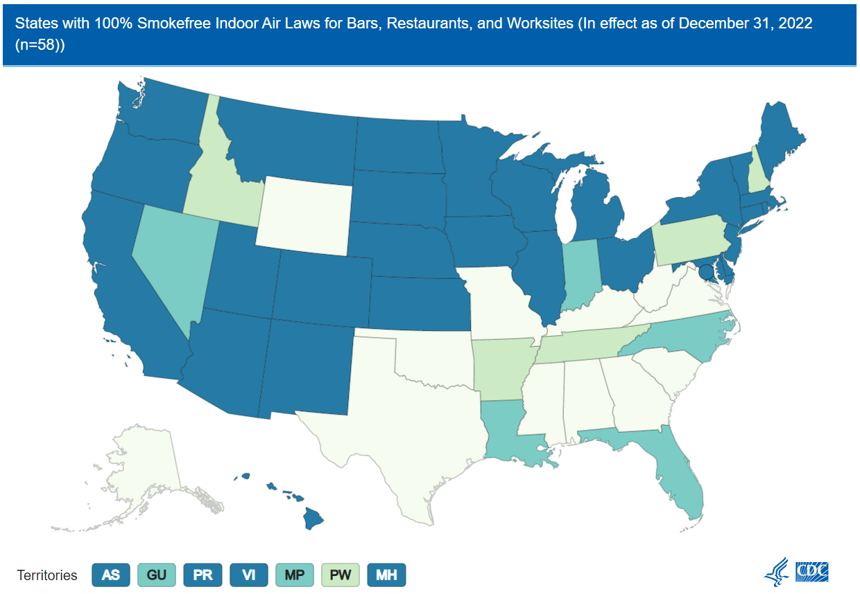
Smokefree Indoor Air – Bars, Private Worksites, and Restaurants
*Virgin Islands = U.S. Virgin Islands
Centers for Disease Control and Prevention (CDC). State Tobacco Activities Tracking and Evaluation (STATE) System. Updated 03/2023
Notes:
This is a map of current comprehensive smokefree indoor air laws on private worksites, restaurants, and bars. The data are grouped into 4 classes defined as: 1) No law, designated, areas, or separate ventilation law; 2) 100% smokefree in one location; 3) 100% smokefree in two locations; and 4) 100% smokefree in three locations.

Slide 19
Smokefree Indoor Air – Bars, Private Worksites, and Restaurants
Location | Type Of Restriction | Bars | Private_Worksites | Restaurants
Alabama | No Law - designated areas - or separate ventilation Law | None | Designated Areas | None
Alaska | No Law - designated areas - or separate ventilation Law | No Provision | No Provision | Designated Areas
American Samoa | 100% smokefree in three locations | Banned | Banned | Banned
Arizona | 100% smokefree in three locations | Banned | Banned | Banned
Arkansas | 100% smokefree in one location | None | Banned | Designated Areas
California | 100% smokefree in three locations | Banned | Banned | Banned
Colorado | 100% smokefree in three locations | Banned | Banned | Banned
Connecticut | 100% smokefree in three locations | Banned | Banned | Banned
Delaware | 100% smokefree in three locations | Banned | Banned | Banned
District of Columbia | 100% smokefree in three locations | Banned | Banned | Banned
Florida | 100% smokefree in two locations | None | Banned | Banned
Georgia | No Law - designated areas - or separate ventilation Law | Designated Areas | Designated Areas | Designated Areas
Guam | 100% smokefree in two locations | Banned | Designated Smoking Area | Banned
Hawaii | 100% smokefree in three locations | Banned | Banned | Banned
Idaho | 100% smokefree in one location | None | Designated Areas | Banned
Illinois | 100% smokefree in three locations | Banned | Banned | Banned
Indiana | 100% smokefree in two locations | None | Banned | Banned
Iowa | 100% smokefree in three locations | Banned | Banned | Banned
Kansas | 100% smokefree in three locations | Banned | Banned | Banned
Kentucky | No Law - designated areas - or separate ventilation Law | No Provision | No Provision | No Provision
Louisiana | 100% smokefree in two locations | None | Banned | Banned
Maine | 100% smokefree in three locations | Banned | Banned | Banned
Marshall Islands | 100% smokefree in three locations | Banned | Banned | Banned
Maryland | 100% smokefree in three locations | Banned | Banned | Banned
Massachusetts | 100% smokefree in three locations | Banned | Banned | Banned
Michigan | 100% smokefree in three locations | Banned | Banned | Banned
Minnesota | 100% smokefree in three locations | Banned | Banned | Banned
Mississippi | No Law - designated areas - or separate ventilation Law | No Provision | No Provision | No Provision
Missouri | No Law - designated areas - or separate ventilation Law | Designated Areas | Designated Areas | Designated Areas
Montana | 100% smokefree in three locations | Banned | Banned | Banned
Location | Type Of Restriction | Bars | Private_Worksites | Restaurants
Nebraska | 100% smokefree in three locations | Banned | Banned | Banned
Nevada | 100% smokefree in two locations | None | Banned | Banned
New Hampshire | 100% smokefree in one location | No Provision | Designated Areas | Banned
New Jersey | 100% smokefree in three locations | Banned | Banned | Banned
New Mexico | 100% smokefree in three locations | Banned | Banned | Banned
New York | 100% smokefree in three locations | Banned | Banned | Banned
North Carolina | 100% smokefree in two locations | Banned | No Provision | Banned
North Dakota | 100% smokefree in three locations | Banned | Banned | Banned
Northern Marianas | 100% smokefree in two locations | No Provision | Banned | Banned
Ohio | 100% smokefree in three locations | Banned | Banned | Banned
Oklahoma | No Law - designated areas - or separate ventilation Law | None | Designated Areas | Separate Ventilated Areas
Oregon | 100% smokefree in three locations | Banned | Banned | Banned
Palau | 100% smokefree in one location | Designated Smoking Area | Banned | Designated Smoking Area
Pennsylvania | 100% smokefree in one location | None | Banned | Separate Ventilated Areas
Puerto Rico | 100% smokefree in three locations | Banned | Banned | Banned
Rhode Island | 100% smokefree in three locations | Banned | Banned | Banned
South Carolina | No Law - designated areas - or separate ventilation Law | No Provision | No Provision | No Provision
South Dakota | 100% smokefree in three locations | Banned | Banned | Banned
Tennessee | 100% smokefree in one location | None | Banned | Designated Areas
Texas | No Law - designated areas - or separate ventilation Law | No Provision | No Provision | No Provision
Utah | 100% smokefree in three locations | Banned | Banned | Banned
Vermont | 100% smokefree in three locations | Banned | Banned | Banned
Virgin Islands | 100% smokefree in three locations | Banned | Banned | Banned
Virginia | No Law - designated areas - or separate ventilation Law | Separate Ventilated Areas | No Provision | Separate Ventilated Areas
Washington | 100% smokefree in three locations | Banned | Banned | Banned
West Virginia | No Law - designated areas - or separate ventilation Law | No Provision | No Provision | No Provision
Wisconsin | 100% smokefree in three locations | Banned | Banned | Banned
Wyoming | No Law - designated areas - or separate ventilation Law | No Provision | No Provision | No Provision
*Virgin Islands = U.S. Virgin Islands
Centers for Disease Control and Prevention (CDC). State Tobacco Activities Tracking and Evaluation (STATE) System. Updated 03/2023
Notes:
This is a map of current comprehensive smokefree indoor air laws on private worksites, restaurants, and bars. The data are grouped into 4 classes defined as: 1) No law, designated, areas, or separate ventilation law; 2) 100% smokefree in one location; 3) 100% smokefree in two locations; and 4) 100% smokefree in three locations.

Slide 20
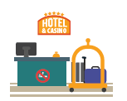
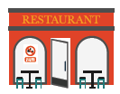
State of the States
Currently, 28 states, 4 Territories, and DC have implemented comprehensive smokefree laws prohibiting smoking in all indoor areas of worksites, restaurants, and bars.¹
33
12 states still do not prohibit smoking in any of the recommended indoor areas of worksites, restaurants, or bars.
Up to 17% average reduction in heart attack hospitalizations in places that enact comprehensive smoke-free laws.²
¹Centers for Disease Control and Prevention (CDC). State Tobacco Activities Tracking and Evaluation (STATE) System.
²Pell JP, Haw S, Cobbe S, Newby DE, Pell ACH, Fischbacher C, et al. Smoke-Free Legislation and Hospitalizations for Acute Coronary Syndrome. New England Journal of Medicine 2008;359:482–91
Updated 03/2023

Slide 21
Based on OSHData datasets: CDC STATE System Tobacco Legislation – Smokefree Indoor Air
1995-2022. Centers for Disease Control and Prevention (CDC). State Tobacco Activities Tracking and Evaluation (STATE) System. Legislation – Smokefree Indoor Air. The STATE System houses current and historical state-level legislative data on tobacco use prevention and control policies. Data are reported on a quarterly basis. Data include information related to state legislation on comprehensive smokefree indoor air in private worksites, restaurants, and bars.
https://chronicdata.cdc.gov/Legislation/CDC-STATE-System-Tobacco-Legislation-Smokefree-Ind/32fd-hyzc

